Slide 1
Data Engineering
Assignment 2
Ahmad Murad

Slide 2
Question
Use the notebook given at https://bit.ly/3ugP8Qg
Build an AirFlow DAG for all pipelines and filters in the United Kingdom (UK).
The output of the pipelines should be
uk_scoring_report.png
uk_scoring_report.csv
PostgreSQL table uk_scoring_report
Provide a GitHub repo for your solution with all required instructions.

Slide 3
Answer Outline
The solution has been built using Docker Containers necessary to manage the pipeline requested in the assignment
The containers build :
Airflow to build the pipeline processing flow, and the main yaml file comes with the below default containers
Webserver
Worker
Schedular
Redis
Init
Postgres SQL ( which is part of the airflow containers)
dpage/pgadmin for Postgres SQL administration
Mongo DB ( not used)
Mongo DB Express to manage the MongoDB ( not Used )

Slide 4
Answer Outline cont.
The pipeline has been constructed to extract Jordan Covid data in 2020 and 2021 only instead of UK for the whole period as it consumes a lot of time and resources due to many files extracted.
The pipeline is built of several PythonOperators , each responsible to do a specific task.
The goal of the pipeline is still the same :
Extract the Covid data for Jordan from the provided repo of John Hopkins statistics
Model fit Scoring using sklearn minmax formula
Extract a png plot of the data including Confirmed ,Deaths , Recovered , Active, Incident_Rate, Case_Fatality_Ratio
Extract the scored report in CSV format
Dump the CSV file into a Postgres database

Slide 5
Files uploaded in Github
Docker-compose.yaml
The yaml file have all the configurations to build all the required containers.
Assignment2.py
Contains the DAG script for the Airflow
This PPT ☺
To present the solution

Slide 6
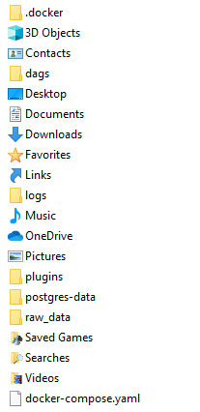
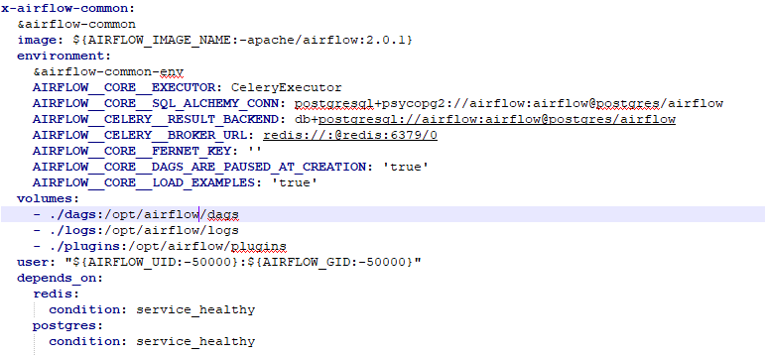
Solution
The files needed to run the solution are :
The docker-compose.yaml file which has all the configuration required to build the containers
The Python Script that defines the DAG , and should be placed in the DAGs folder which is mounted to the

Slide 7
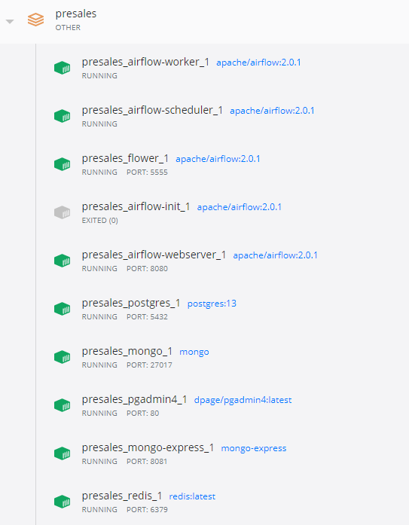
Solution cont.
In the same location where the yaml file is copied run the below command :
docker-compose up
This command will build all the containers
All ports needed has been mounted
All folders needed ( dags, logs , plugin for the airflow ,and Postgres datafiles ) has been mounted.

Slide 8
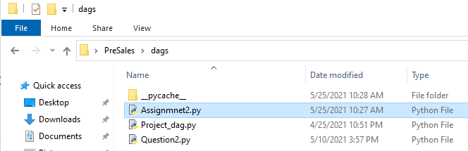
Solution cont.
In the same location where the yaml file is copied run the below command :
docker-compose up
This command will build all the containers
All ports needed has been mounted
All folders needed ( dags, logs , plugin for the airflow ,and Postgres datafiles ) has been mounted.
Copy Assignment2.py in the dags folder
restart: always

Slide 9
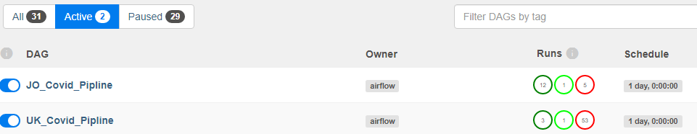
Airflow Pipeline
Access the airflow interface by typing : Localhost:8080 in the web browser
Click on DAGs and you should find the below DAG (JO_Covid_Pipline) added to the list
you can see in the snapshot another pipeline for UK , it was created but it took very long time to complete.

Slide 10
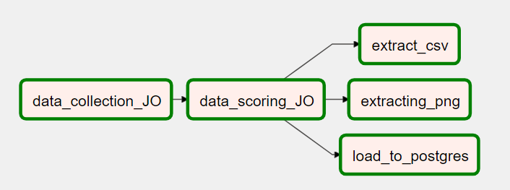
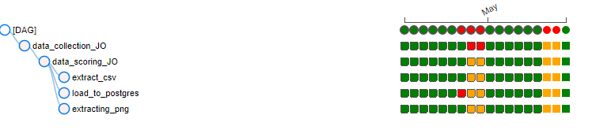
Airflow Pipeline
Click on the JO_Covid_Pipline DAG and select the graph view
The airflow DAG after building the python script is presented as below

Slide 11
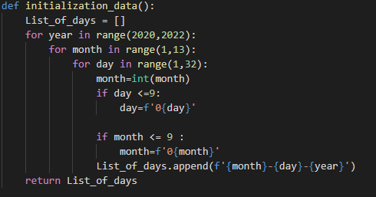
Extracting Jordan Data
The first step was to build the list of days in order to use it as a parameter in the file name URL string
The Month and Day checks at 9 is to add an indent 0 to maintain the used format in the file
The function return a

Slide 12
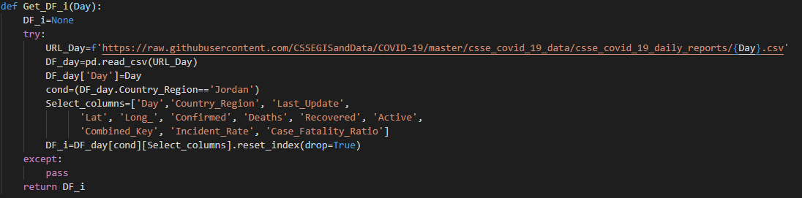
Extracting Jordan Data
Then a function GET_DF_i is built to extract the daily file from the URL and return in a Pandas DataFrame object , in takes a sting represent the Day that we intended to extract the file with.

Slide 13
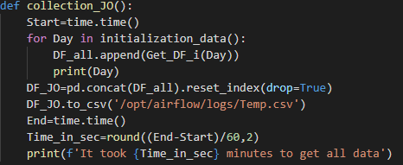
Extracting Jordan Data
The final stage is to call the collect function which will simply have a for loop that will go through the Days list and extract all the files , then append or merge the DataFrames in the list into one and then extract it into a CSV file and drop it on the server under this location
/opt/airflow/logs/Temp.csv

Slide 14
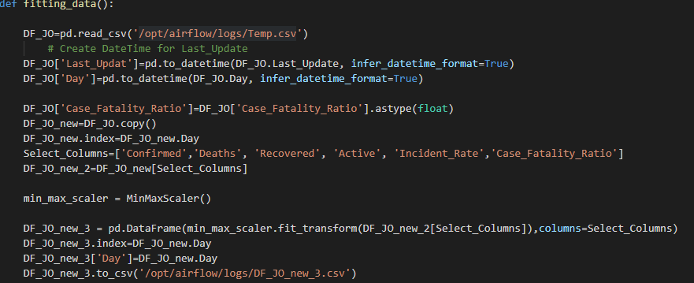
Fitting the Data for Scoring Scale
In this function we start by reading the csv file generated from the previous step , process the Last_Update and Day fields to be in datetime format , and also the case_Fatality_Ratio to be float.
Then we fit the data with Sklearn min_max scale
Then we drop a modified
Version of the CSV on the
Server with the name :
/opt/airflow/logs/DF_JO_new_3.csv

Slide 15
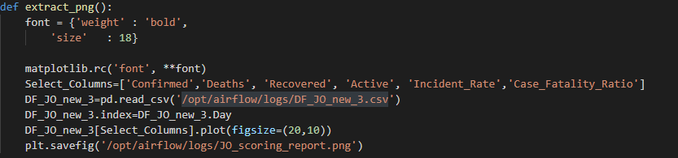
Exporting the PNG Plot
In this function we read the modified csv file generated from the previous step
Using matplotlib.pyplot we plot the readings and numbers in the CSV file
Then we safe the figure in the location :
/opt/airflow/logs/JO_scoring_report.png

Slide 16

Extracting to CSV
This step already done , but in this function we read the file and then save it in different name ☺

Slide 17
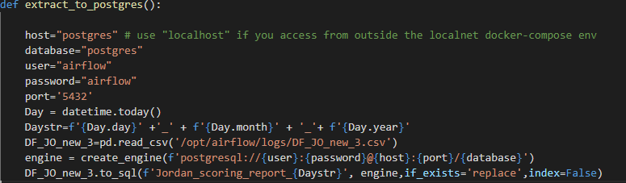
Dropping data into Postgres
In this function we load the generated and modified CSV file
We connect the Postgres database
We defined a Day time stamp string to be used to create the table name with todays data
We drop the CSV file in a newly created table as below

Slide 18
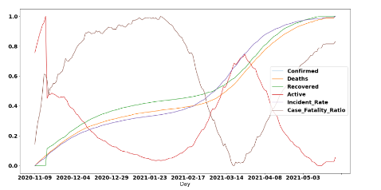
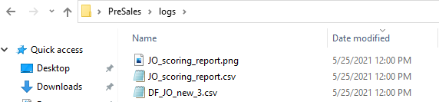
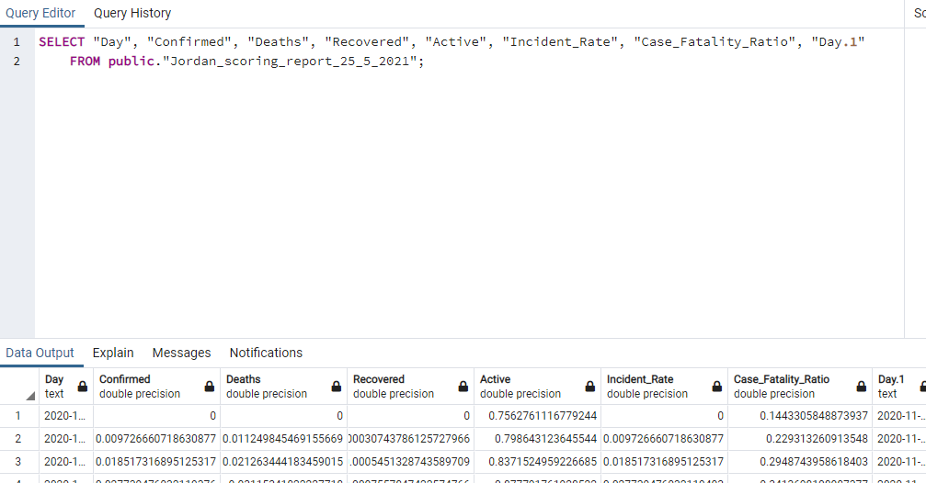
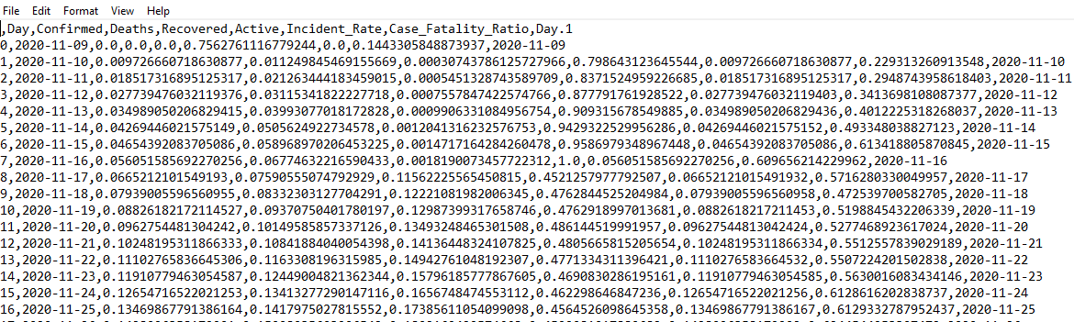

Final Result
The Pipeline will drop all the extracts as required.

